Slide 1
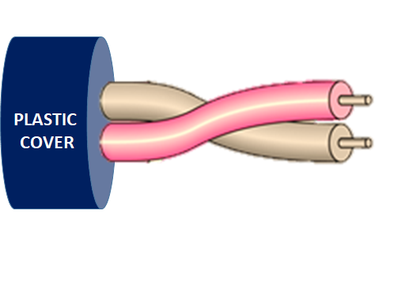
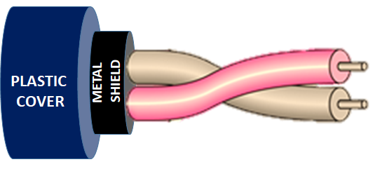
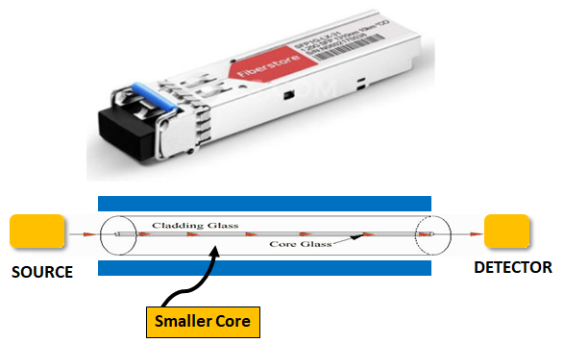
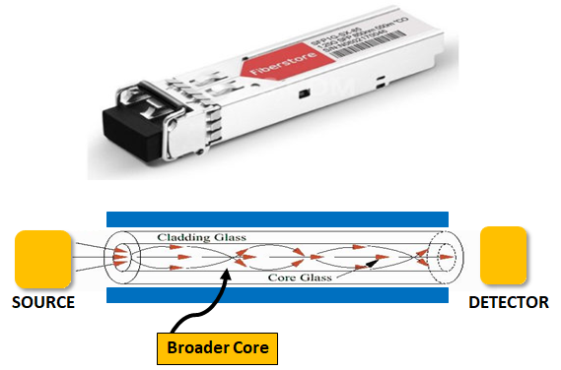
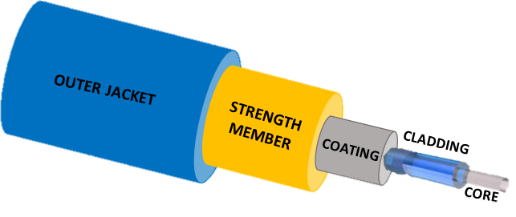
Types of Network Cables
Feature | Coaxial | UTP (Unshielded Twisted Pair) | STP (Shielded Twisted Pair) | Single Mode Fiber | Multimode Fiber | Fiber Optic (General)
Medium | Copper | Copper | Copper | Glass (or plastic core) | Glass (or plastic core) | Glass or Plastic
Transmission Type | Electrical | Electrical | Electrical | Light (Laser) | Light (LED) | Light (Laser or LED)
Max Distance | ~500 meters | 100 meters (Cat 5e/6) | 100 meters (Cat 5e/6) | Up to 40–100 km | Up to 2 km | Varies by type
Data Rate | Up to 10 Mbps (older types) | Up to 10 Gbps (Cat 6a/7) | Up to 10 Gbps (Cat 6a/7) | 10 Gbps to 100+ Gbps | 10 Gbps (typical max) | 10+ Gbps
EMI Resistance | Moderate | Low | High | Very High | Very High | Very High
Cost | Low | Low | Moderate | High | Moderate | High
Installation Complexity | Easy | Easy | Slightly more complex | Complex | Moderate | Complex
Typical Use Cases | TV, CCTV, legacy LANs | Ethernet LANs | Industrial or noisy environments | Long-distance backbone links | Short-distance backbone links | WANs, high-speed networks
Connector Type | BNC, F-type | RJ-45 | RJ-45 (with shielded connectors) | LC, SC, FC | LC, SC, ST | LC, SC, FC, ST
Bandwidth | Low | Medium to High | Medium to High | Very High | High | Very High
Durability | Moderate | Moderate | Moderate | High | High | High
networkinterview.com
networkinterview.com
Rashmi Bhardwaj
networkinterview.com
(An Initiative By ipwithease.com)

